Slide 1
Mathimithra KVV
Electric Vehicles Market Size Analysis
3/21/2024 Annual Review

Slide 2
PROJECT TITLE
Electric Vehicles Market Size Analysis
3/21/2024 Annual Review

Slide 3


AGENDA
Market size analysis is a crucial aspect of market research that determines the potential sales volume within a given market. It helps businesses understand the magnitude of demand, assess market saturation levels, and identify growth opportunities.
3/21/2024 Annual Review

Slide 4

PROBLEM STATEMENT
As the electric vehicle (EV) market continues to expand rapidly, there is a pressing need for accurate and reliable market analysis and prediction methodologies to guide stakeholders in navigating this dynamic landscape effectively. Key challenges in conducting EV market analysis and prediction include:
Industry Growth and Investment
Resource Allocation Optimization
Competitive Strategy Development
3/21/2024 Annual Review

Slide 5

PROJECT OVERVIEW
The project aims to conduct a comprehensive analysis and prediction of the electric vehicle (EV) market, focusing on understanding current trends, forecasting future demand, and identifying growth opportunities. Leveraging advanced data analytics and statistical modeling techniques, the project seeks to provide stakeholders with actionable insights to inform strategic decision-making and drive the sustainable growth of the EV industry.
3/21/2024 Annual Review

Slide 6

WHO ARE THE END USERS?
The results of the analysis and prediction are presented in a clear and concise manner, using visualizations and charts to enhance understanding. Key findings, trends, and implications are interpreted, providing actionable recommendations for stakeholders, including EV manufacturers, investors, policymakers, and consumers.
In conclusion, the project highlights the significance of accurate market analysis and prediction in driving informed decision-making and shaping the future of electric mobility. It identifies areas for future research and development, aiming to further improve the accuracy and effectiveness of EV market analysis methodologies and contribute to the sustainable growth of the EV industry.
3/21/2024 Annual Review

Slide 7
YOUR SOLUTION AND ITS VALUE PROPOSITION
For the task of market size of electric vehicles analysis,
I have taken the following attributes:
EV Adoption Over Time: Analyze the growth of the EV population by model year.
Geographical Distribution: Understand where EVs are most commonly registered (e.g., by county or city).
EV Types: Breakdown of the dataset by electric vehicle type (BEV, etc.).
Make and Model Popularity: Identify the most popular makes and models among the registered EVs.
Electric Range Analysis: Analyze the electric range of vehicles to see how EV technology is progressing.
Estimated Growth in Market Size: Analyze and find the estimated growth in the market size of electric vehicles.
3/21/2024 Annual Review

Slide 8

THE WOW IN YOUR SOLUTION
Data Collection and Preprocessing
Market Analysis
Predictive Modeling
Scenario Analysis
Visualization and Reporting
Strategic Recommendations
Continuous Monitoring and Iteration
3/21/2024 Annual Review

Slide 9
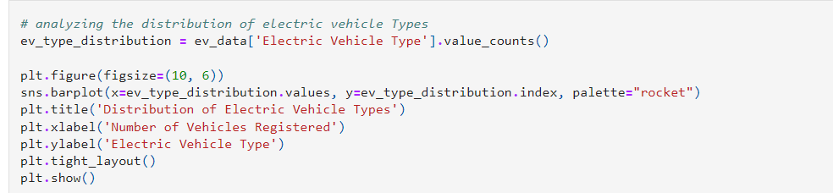
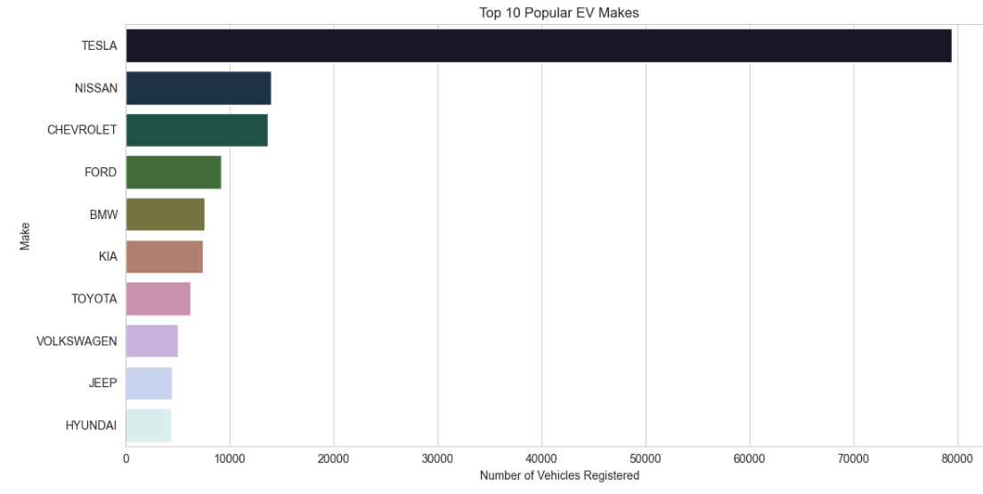

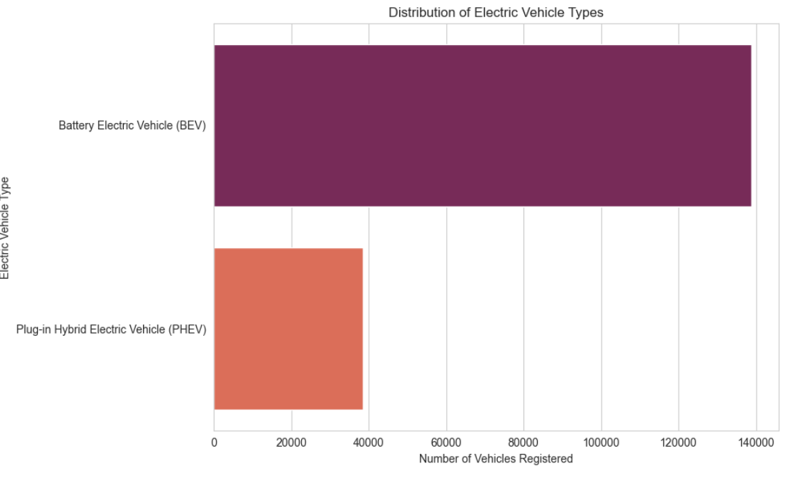
MODELLING
3/21/2024 Annual Review

Slide 10
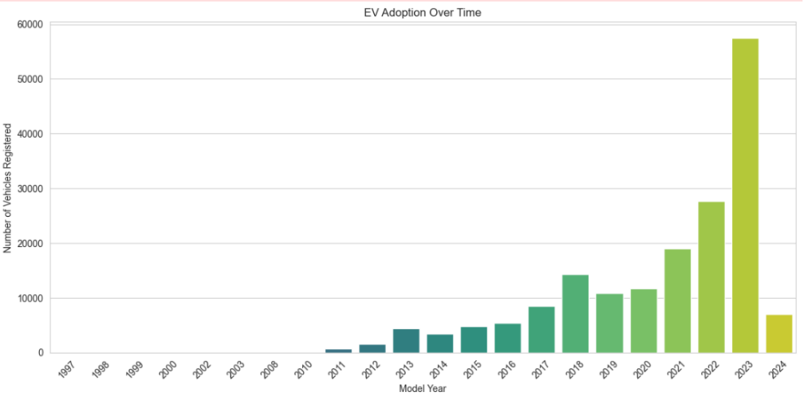
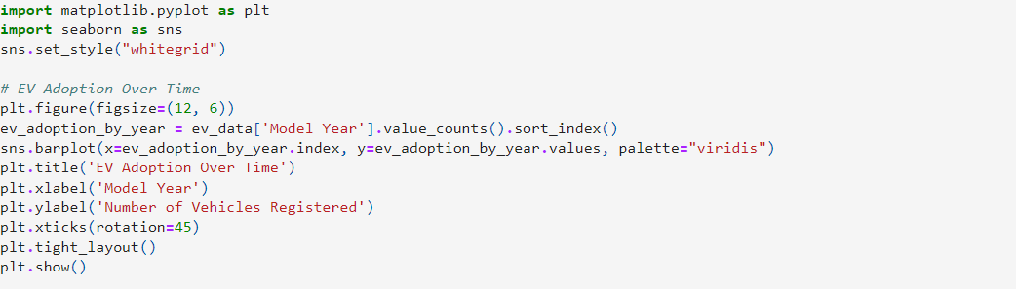
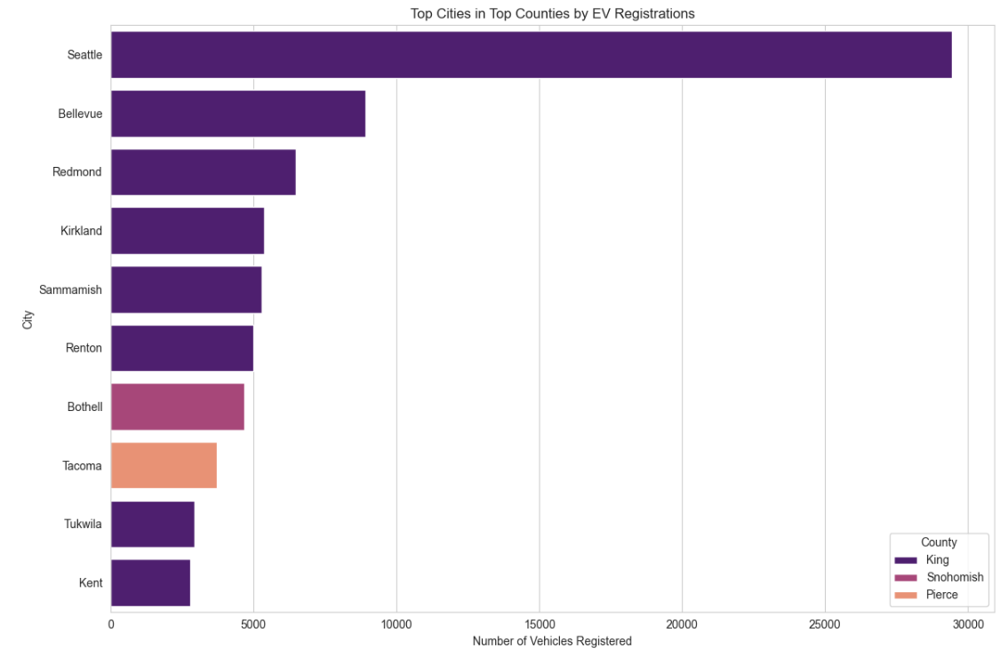

MODELLING
3/21/2024 Annual Review

Slide 11
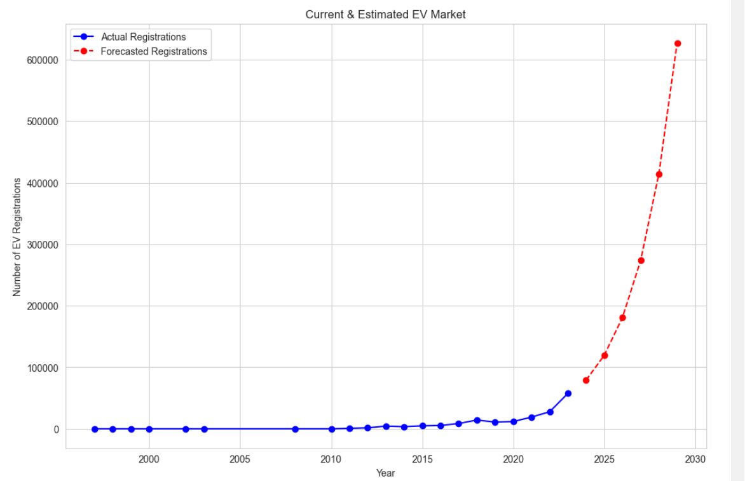
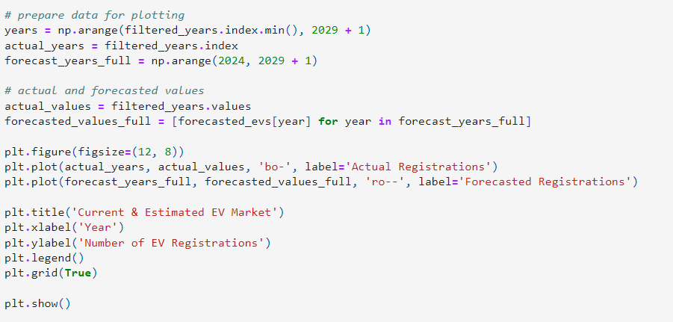
MODELLING
3/21/2024 Annual Review

Slide 12
RESULTS
From the above graph, we can see:
The number of actual EV registrations remained relatively low and stable until around 2010, after which there was a consistent and steep upward trend, suggesting a significant increase in EV adoption.
The forecasted EV registrations predict an even more dramatic increase in the near future, with the number of registrations expected to rise sharply in the coming years.
From our market size analysis of electric vehicles, we found a promising future for the EV industry, indicating a significant shift in consumer preferences and a potential increase in related investment and business opportunities.
DEMO LINK : https://github.com/MathimithraKVV/mathimithra-NM-AI
3/21/2024 Annual Review

